Slide 1
Spring 2025 Tools and Technologies Final Project
By Robert Palmer

Slide 2
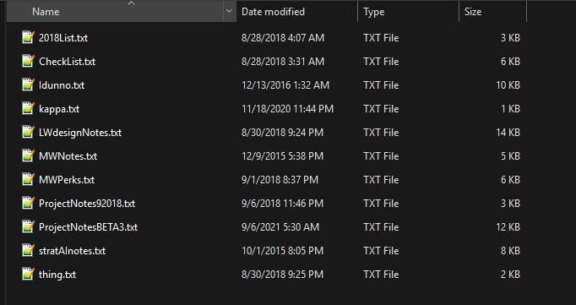
Favorite Tool
Surprisingly, I liked using Git, even with the learning curve
I’ve had personal projects in the past collapse due to lack of version control or having a central repository for files and changes
Look at these attempts over many years to remember what I was doing and what my thoughts were at the time
Every time I come back to this project I spend weeks rereading notes. What was I even doing ten years ago? It is a mystery. Eventually I give up until the next time

Slide 3
Everything in one place
A Git repository keeps everything in one place in the cloud, making finding and recovering files much easier than digging through directories on a hard drive from 2016.
Git makes it easier to share files and keep records. I used to be part of a broader modding community that has since faded away. Much of the outside coding expertise I used to rely on is now lost in ancient chat rooms. If we had used Git there would still be a record of their contributions

Slide 4
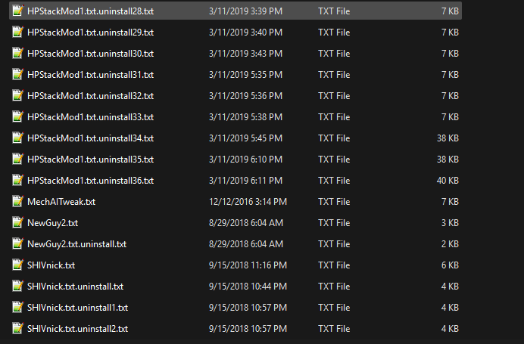
Version control
There are 36 attempts to fix one file listed here.
I have no idea what the problem was or how I fixed it. Or even if I fixed it.
What was I trying to achieve? I don’t know! There are no records except for 36 uncommented ‘undo’ files
Git would at least have a changelog, even if I didn’t submit comments with my commit

Slide 5
What project is git suited for?
Git is best suited for any text heavy project where tracking changes is important.
The changes can be version control or credit for collaboration
Git is also well suited to creating branches of a working project for experimentation without wrecking the working version, and easily reverting failed changes
Coding
Documentation
Collaborative Writing
Free is a pretty good price for small projects

Slide 6
What is Git bad at?
Ultimately, the cloud is just other people’s computers. Your data is only as secure as their servers.
Git has maximum storage of just 500 MB with 1 GB of data transfer a month for free accounts. While this is a lot for text, its not very much for larger projects involving images or video.
Git has very basic markdown support and it’s annoying to view anything other than markdown files without opening them locally.
Anything complex is probably better done in another tool

Slide 7
Scenario 1
Sole writer
Small startup
Limited funds
New web app with mobile version
No translation

Slide 8
Free is good
I would rather they add the few thousand dollars an Oxygen license would cost to my salary, or failing that to making sure the product launches successfully so I can continue to draw a salary. Expensive licenses are for companies that can consistently make payroll.
This leaves me with Git for version control, Markdown, basic HTML, and pretending my personal Office license is actually commercial and hoping nobody checks. ReST exists as well.

Slide 9
HTML is good enough
If the design requirements only call for documentation for a web app that can be read on desktop and mobile, basic HTML with display tags is going to be good enough.
It might not be the fanciest, but it will get the job done until we hit it big and get into feature bloat.
The developers would have just put the documentation in a plain text file anyways. Any kind of structure is a solid step up.
Most likely the documentation won’t scale at all with future versions, but a small web app is either going to hit it big and have the budget to start over, or it’ll stay small enough for manual edits to raw HTML to be viable.

Slide 10
I did not care for rest
I think its honestly just the aesthetic
I would rather use anything else

